Slide 1
Tutorial For Ordering Spare Parts
Login now at https://spareparts.sacmiusa.com/

Slide 2
SACMIUSA Customer Login Page New User? Request Access

Slide 3
After Requesting Access, You’ll Receive An Email. Click The Following Link

Slide 4
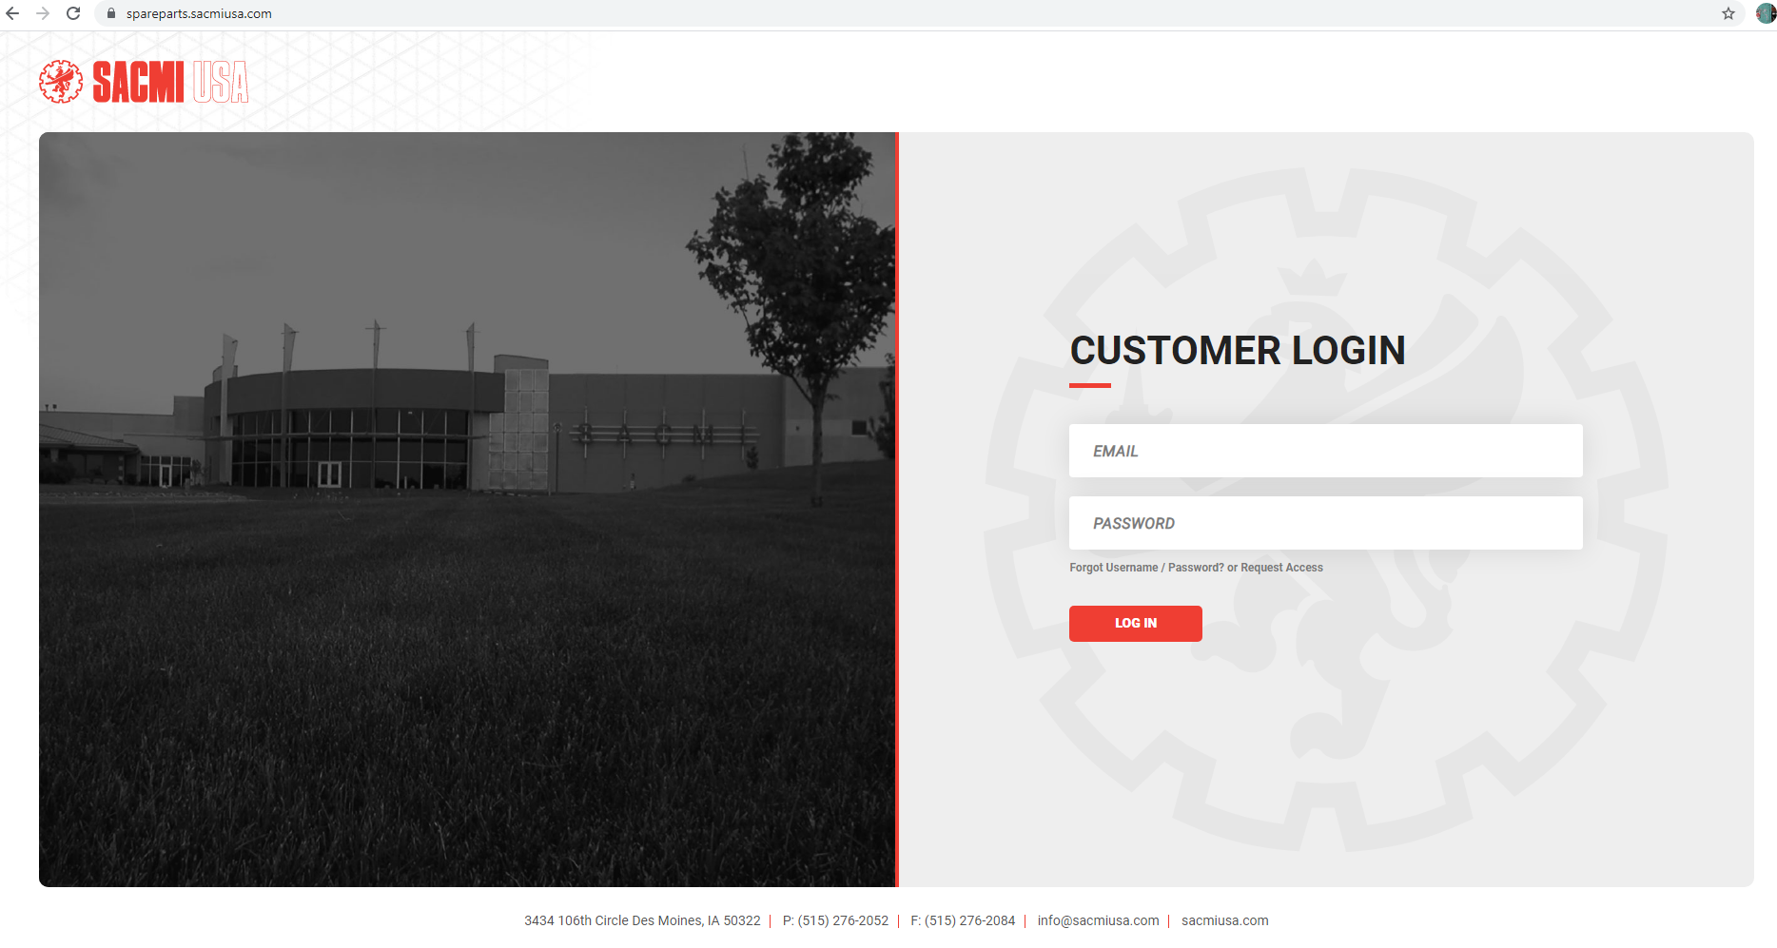
SACMIUSA Customer Login Page If You Already Have Access

Slide 5
SPAREPARTS.SACMIUSA.COM MAIN PAGE

Slide 6
Requesting A New Quote

Slide 7
Create Quote

Slide 8
Add Material

Slide 9
Type Part Number In Quick Search

Slide 10
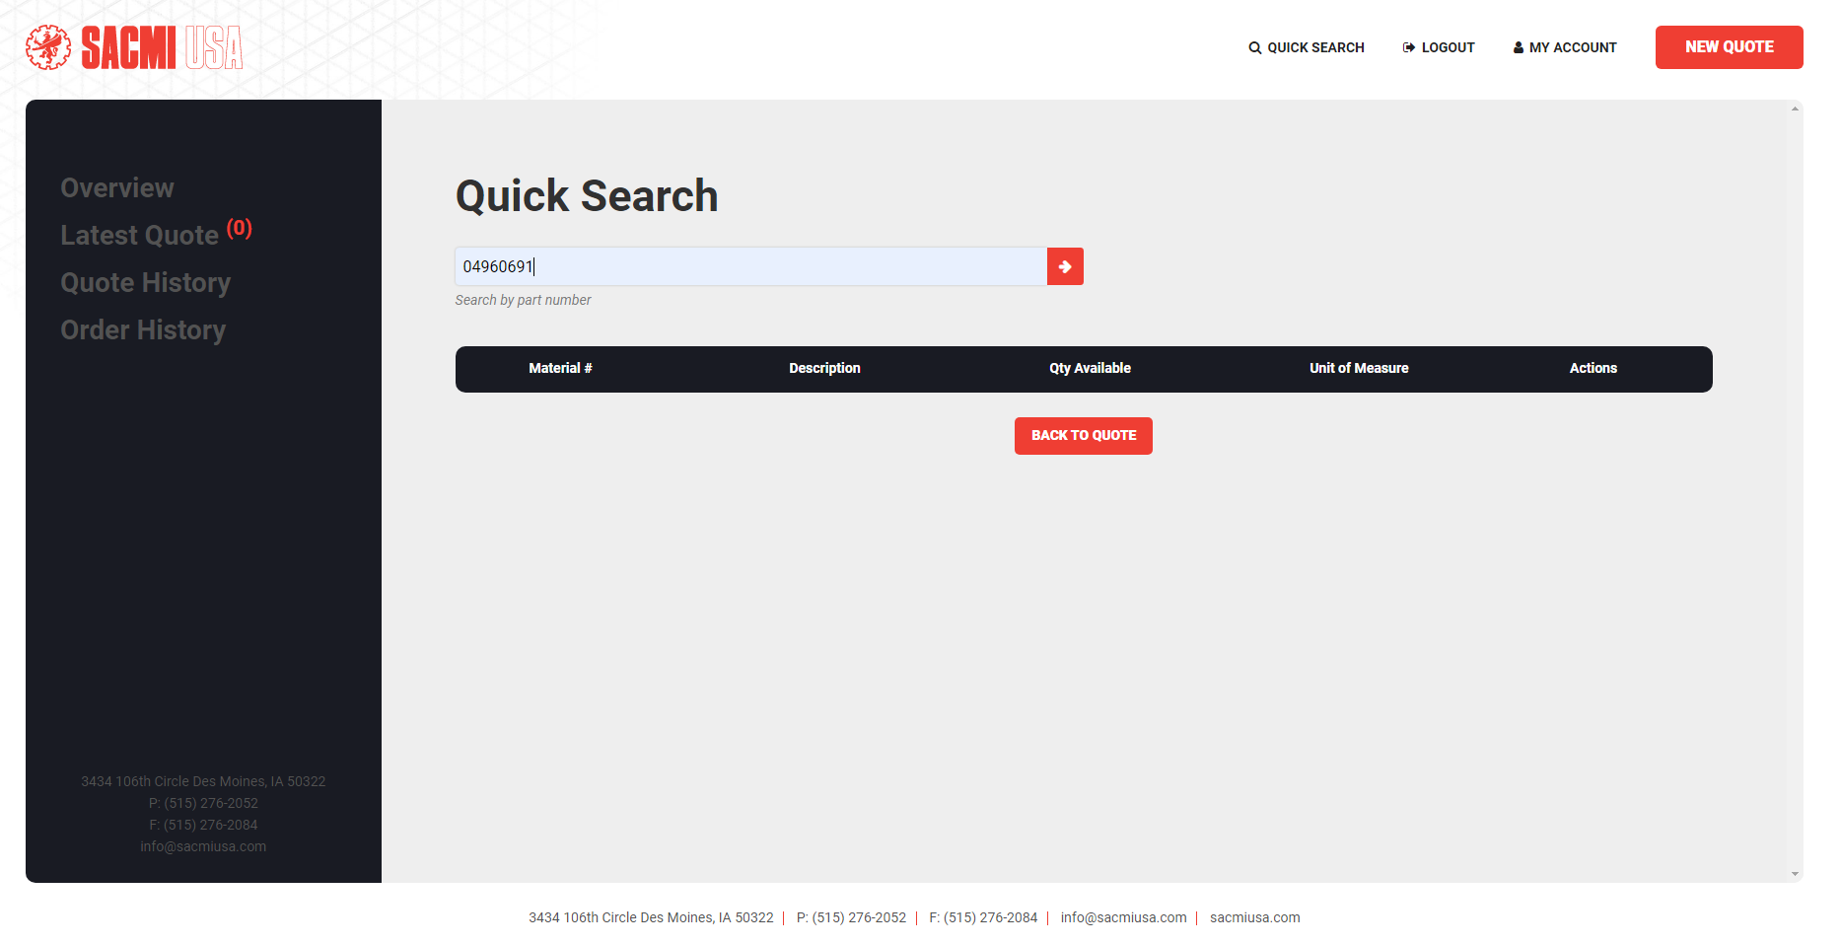
Type Part Number/Quick Search

Slide 11
After You Click Quick Search, Your Part Will Appear. Click Red “I” Button.

Slide 12
Enter Quantity, Click Add To Quote

Slide 13
Quantity and details
In This Field You See
Material
Description
Available Quantity
Unit Of Measure
Price Per Unit

Slide 14
Finishing quote. Click On Overview
After Clicking Add to Quote Your Quote Will Show Up On The Next Page

Slide 15
Submitting Quote, Click On Red Pencil Under Actions

Slide 16
Submitting quote

Slide 17
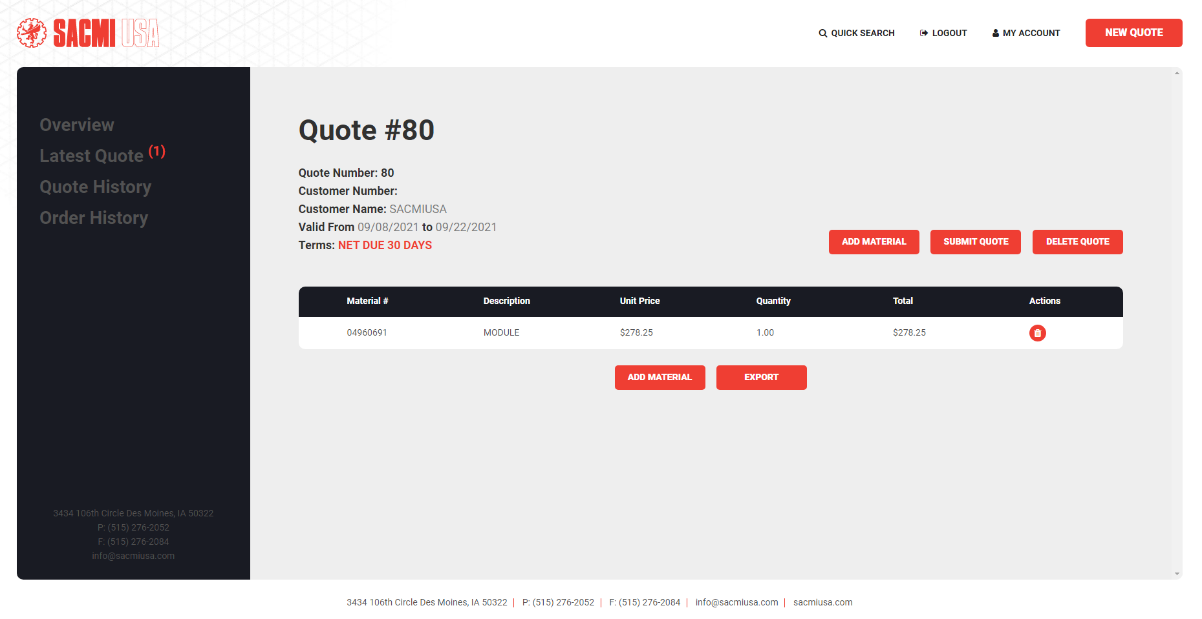
Adding Material Deleting Quote

Slide 18
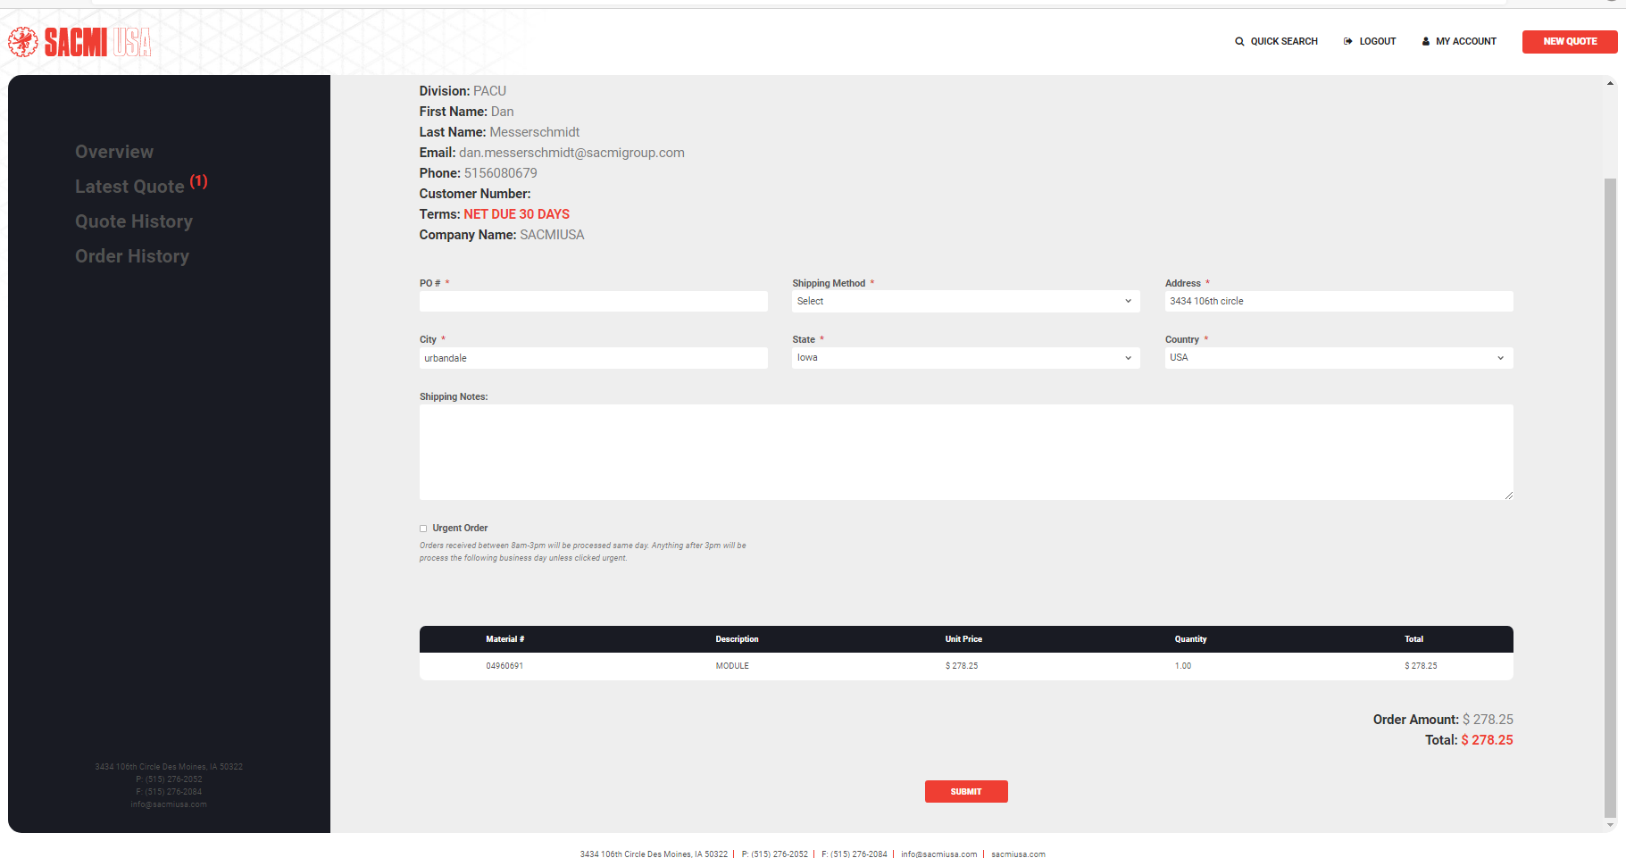
Final Steps For Your Order. Fill Out Information, Click Submit

Slide 19
Logging Out

